Slide 1
Testing Functional Code
Exercise:
- Retrospective

Slide 2
The purpose of this lesson is to show it is possible to have code that is simple to test…
Because many people have never experienced that.

Slide 3
Awareness (show) Proficiency (do) Fluency (repeat)

Slide 4
0 -> 1

Slide 5
Steps 1. Test (fail, get information) 2. Test (pass, locking results) 3. Check coverage (guidance)

Slide 6

HOW HARD WAS THIS?
Very
Not at all

Slide 7
HOW DID THIS FEEL?
💬

Slide 8
RESEMBLE YOUR WORK?
Completely
Not at all

Slide 9
EASIER TO TEST… WHY?
💬

Slide 10
Small methods?
#2
double TrigMath::cot(double angle) { auto idx = floor(angle * SIN_CONVERSION_FACTOR); idx += 1; idx = 3.1 * idx; auto dx = 2.1; for ( int i = 0; i <= 10; ++i ) { idx = (idx * dx * 9.7) / 42.0; } idx = integrate(idx, 2, 13); idx += pow(idx, 2); idx = tan(idx); idx = idx * DEG_TO_RAD; idx = integrate(idx, 2, 13); idx += pow(idx, 2); idx = tan(idx); idx = idx * DEG_TO_RAD; idx = integrate(idx, 2, 13); idx += pow(idx, 2); idx = tan(idx); idx = idx * DEG_TO_RAD; return cosRaw(idx) / sinRaw(idx); }
#1
double TrigMath::tan(double angle) { auto idx = floor(angle * SIN_CONVERSION_FACTOR); return sinRaw(idx) / cosRaw(idx); }
#3
double TrigMath::sec(double angle) { return angle / rand(); }

Slide 11
Functional Code (Pure Functions)
1. All inputs
2. deterministic
3. All results

Slide 12
Non-Functional Code
(No Inputs)
get inputs from global state;
use random, dates, or other varying data;
write results to global state;
(No Return)

Slide 13
All inputs in
public double calculate(double amount)
{
int step1 = (int) (amount * 2);
double step2 = step1 * 1.5;
return step2;
}
Deterministic
All results out

Slide 14
All inputs in?
public int Advance()
{
return steps++;
}

Slide 15
All inputs in?
public int age(DateTime birthDate)
{
var timeSpan = DateTime.Now - birthDate;
var age = DateTime.MinValue + timeSpan;
return age.Year-1;
}
Deterministic?

Slide 16
All results out?
public void saveFile(Person info, string fileName)
{
File.WriteAllText(fileName, info.ToString());
}

Slide 17
Why functional is easier for tests
Unit Test
Production Code
Do
Verify

Slide 18
Why functional is easier for tests
Unit Test
Functional Harness
Production Code
Do
Verify

Slide 19
Benefits of Unit Tests
Specification
Feedback
Regression
Granularity

Slide 20
Benefits of Unit Tests
Specification
Feedback
Regression
Granularity

Slide 21
Regression
A
A
If I used to get :
Then I still get :
Notes:
Both

Slide 22
Stages of Approval Testing
REQUIRE (object == "")
Same?
Pass
Fail
Manually inspect the answer
object
Correct, copy to expected
Wrong, fix code
Notes:
What’s actually happening with Approvals

Slide 23
Locking test

Slide 24

Poke

Slide 25
Next Steps
making your code easy to test

Slide 26
Next Steps
making your code easy to test

Slide 27
Next Steps
better ways of testing functional
making your code easy to test

Slide 28
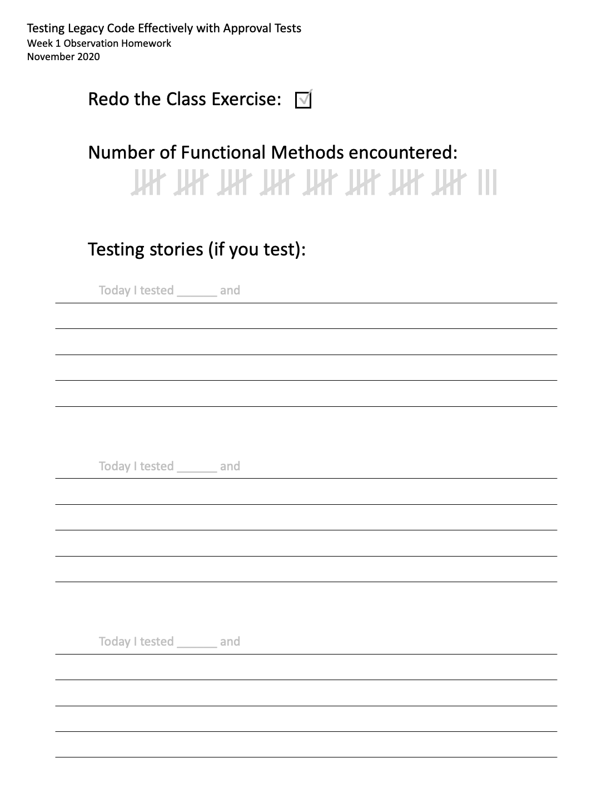
Homework
Redo the exercise, solo
Count functional at work
Stories (if you test)

